Slide 1
Present status of the S-111 Product Specification
Kurt Hess and Greg Seroka, NOAA, USA
COMPONENTS OF THE S-111 PRODUCT SPECIFICATION
Main Document (ver. 1.0.0, pending this meeting)
Metadata conforms to S-100 3.0.0
Data Classification and Encoding Guide
Establish Feature and Attributes (F&A) (Done, Annex A)
Enter F&A into the IHO GI Registry (Done)
3. Feature Catalogue (XML) (Done, Annex D)
4. Portrayal Catalogue
Establish Symbol (Done)
Convert Symbol into SVG Files (Done)
Portrayal rules – plain text (Done, Annex J), Annex J)
Portrayal Rules (XSL) (Done)
Enter symbol into Portrayal Register (Done)
Exchange Format (HDF5 reorg., pending this meeting)
S-111 EXCHANGE FILE CREATION
S-100 Dataset (HDF5) (Samples created)
Catalogue File (XML) (To be done)
Notes:
-Raphael Malyankar developed symbol, SVG, portrayal rules
-2nd section (S-111 exchange file creation) is U.S. (NOAA) and other TWCWG Member States acting as data producers
-Catalogue file (XML) starting to be generated by NOAA/NOS/OCS/CSDL/GADB

Slide 2
Issues recently addressed
Interoperability (symbol colour):
Project Team (PT) added dark outline
Data Quality (DQ):
PT consolidated and emphasized DQ information
HDF5 file structure:
Configuration has been revised several times
Notes:
-Dark outline on arrow based on S-100 TSM5
-Data quality: DQWG (requirements not defined yet) had an informal review, feedback was integrated; DQ part was expanded, providing references of where data has been stored; uncertainty was addressed

Slide 3
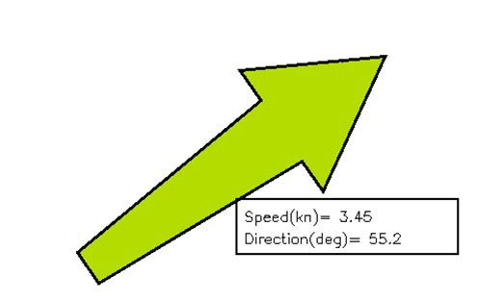
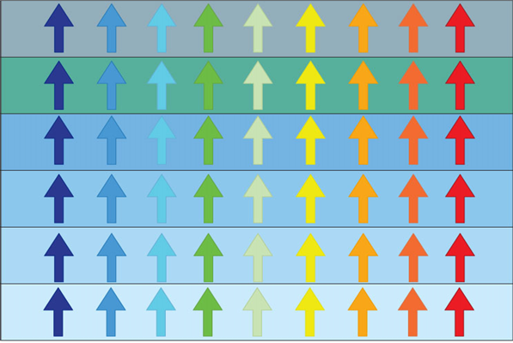

Interoperability:
revised arrow symbols (with border)
A. Original (without border)
B. With border
Depth values
No values
Intertidal
Very shallow water
Medium shallow water
Medium deep water
Deep water
Notes:
-Is the added dark outline sufficient?

Slide 4
Creation of S-111 HDF5 files
Four data/file types:
1. Stationary platform
2. Regularly gridded
3. Ungeorectified gridded
4. Moving platform
Several Member States (MS) in TWCWG have created test files
Primarily for stationary and regularly gridded
MS awaiting final format
But, no viewer is presently available

Slide 5
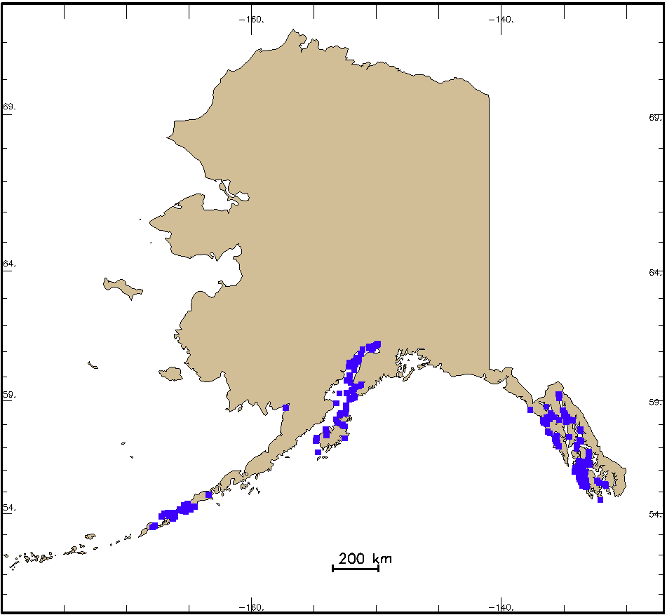
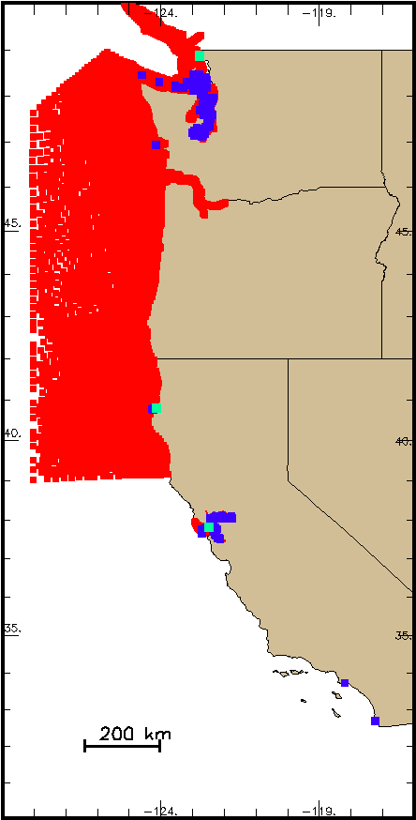
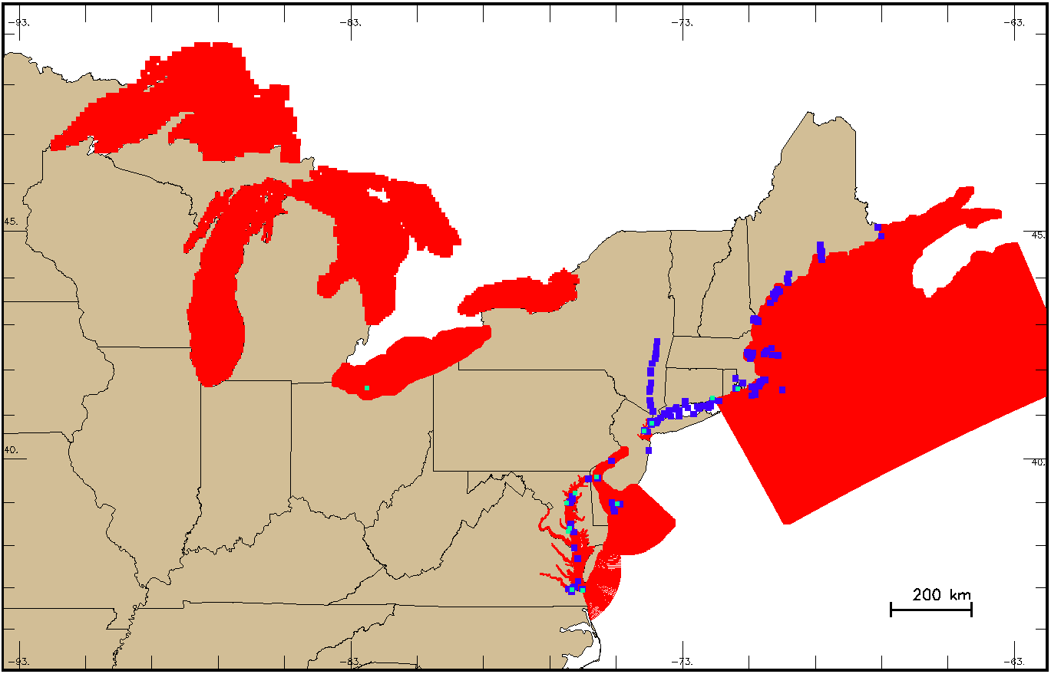
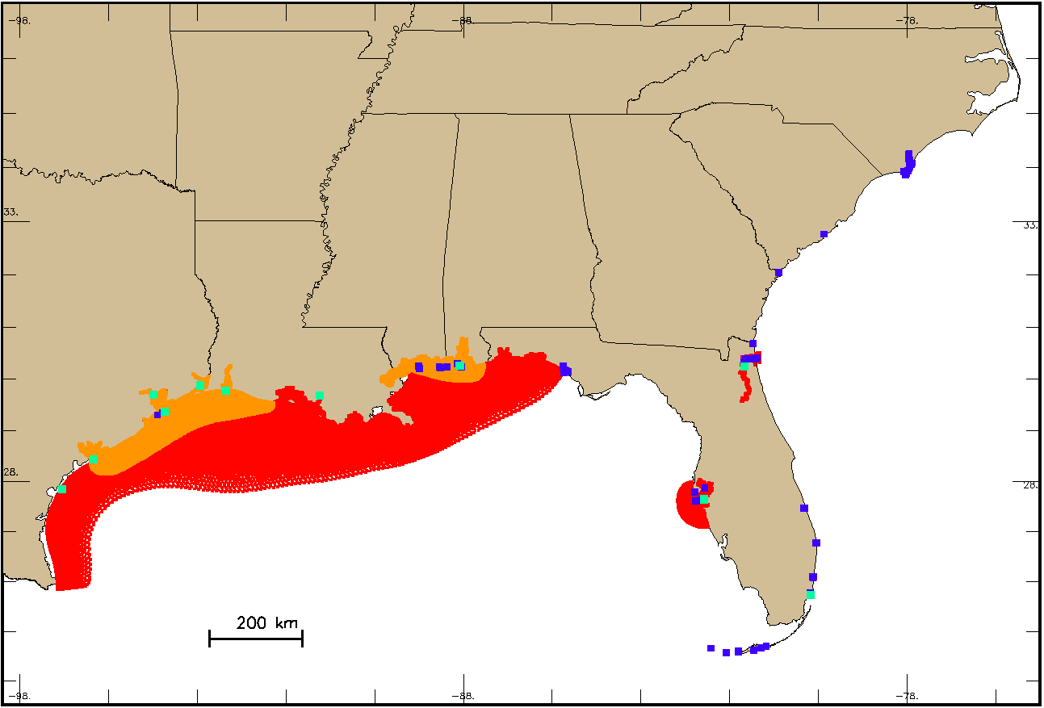
US/NOAA sources of currents data: forecast systems, real-time obs., HC predictions
North East
Alaska
Fcst systems (16)
Real time obs (~30)
HC predictions (1647)
South East and Gulf Coast
West Coast

Slide 6
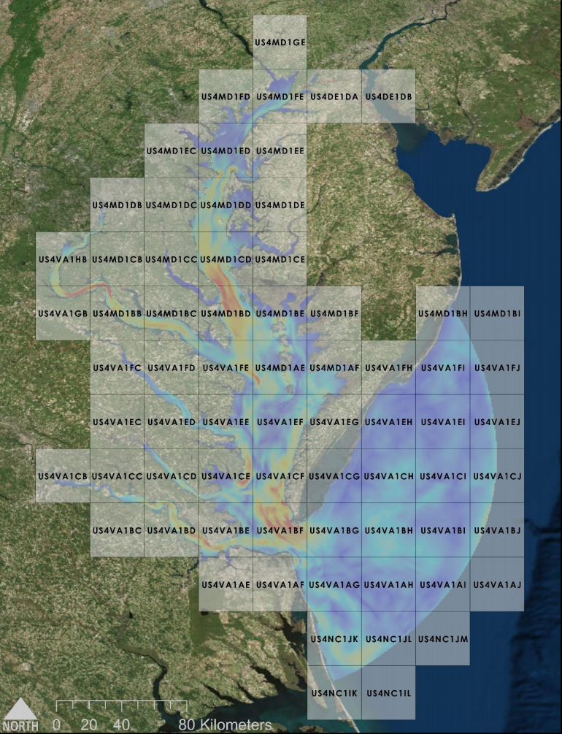
NOAA’s semi-operational production of S-111 HDF5 files
Predicted currents from the Chesapeake Bay
Operational Forecast System
Interpolated to a regular grid (500 by 500 m), at 4.5m depth below surface
Supply currents in separate files, at
high-resolution (band 4: 1 to 40k/80k) digital chart scale
69 Datasets, overall grid file size of ~12 MB
4 times daily cycle (0, 6, 12, 18 UTC), forecasts are hourly out to 48 hours (f00-f48)
Chesapeake Bay, with charts

Slide 7
Anticipated future S-111 actions
1. Make changes to S-111 PS and HDF5 file formats as per this meeting
2. Discuss additional HDF5 format changes (indexing, time dimension)
3. Explore data compression approaches (chunking, zip)
4. Develop XML exchange datasets
5. Prepare tutorials on HDF5 production for Member States
Notes:
For 2 and 3. I mean to say that these items will likely be discussed at TWCWG. They are available already in the new HDF format.
For 4, the XML exchange datasets are additional files that are to be sent out with the HDF files. It's not directly part of the PS.
For 5, I was referring to Canada's tutorials, and the possibility that TWCWG may help some of the MS in developing code to produce the datasets.

Slide 8
Supplementary Slides

Slide 9
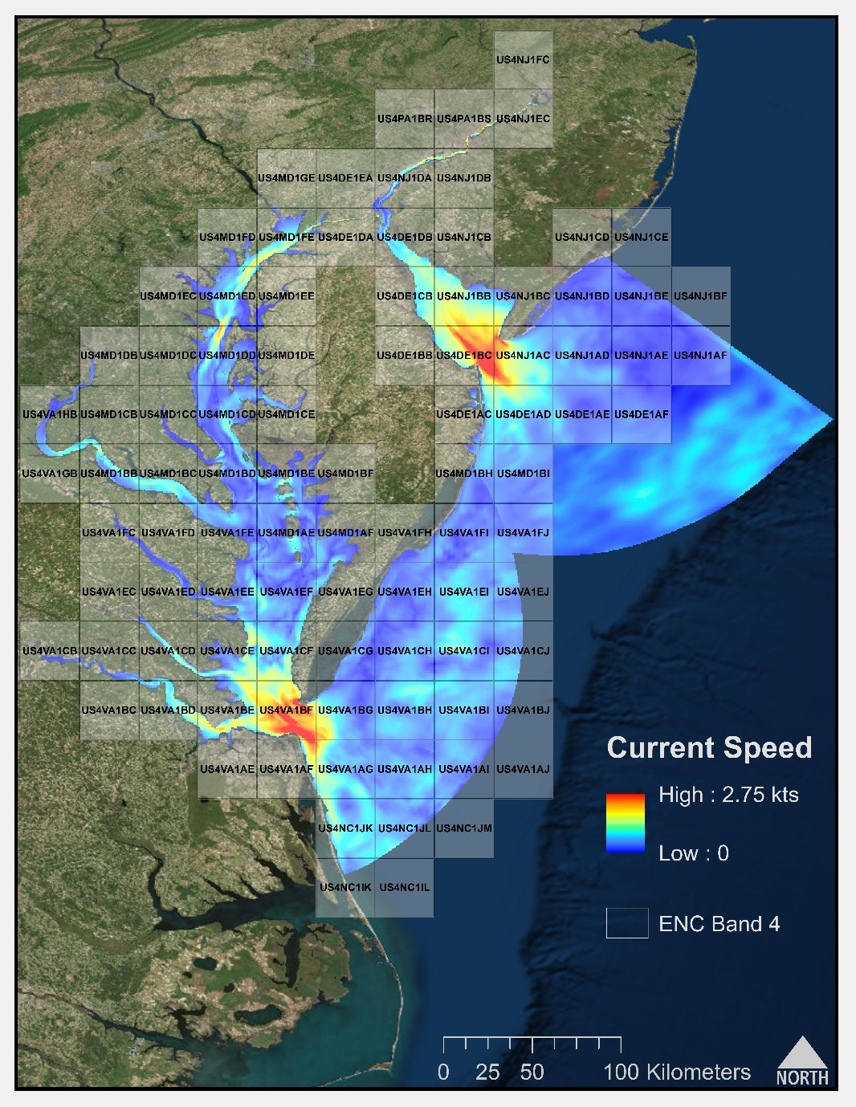
Chesapeake Bay and Delaware Bay, with charts

